Slide 1
Implementing Canada’s plan to address climate change and grow the economy
Putting a price on carbon pollution April, 2019

Slide 2
Pan-Canadian Carbon Pollution Pricing Benchmark
2016: Carbon pollution pricing a key pillar of Canada’s national climate plan
Built on leadership by provinces with carbon pricing already in place
Oct. 2016: federal government announced the pan-Canadian carbon pollution pricing benchmark
Gave provinces and territories two years to implement their own system that meets stringency criteria (‘the benchmark’)
Consistent coverage, price (or consistent impacts for cap-and-trade)
Alternatively, federal ‘backstop’ system would apply if requested or if no system in place that meets the federal benchmark
All proceeds returned to the jurisdiction of origin
Reviews in 2020 and 2022 to determine the path forward
October 2018: Benchmark decisions announced

Slide 3
Federal carbon pollution pricing backstop system
Hybrid system with two components:
Fuel charge
Applied to all fossil fuels
Generally payable by fuel producers or distributors
$CAD 20/t CO2e in 2019
rising by $CAD 10 per year to $CAD 50/t in 2022
Output-based pricing system (OBPS) for large industry
Regulated trading system
Addresses competitiveness and carbon leakage risks for industrial facilities, relieving them from fuel charge
Applies a price to a portion of emissions above sectoral performance standards
Emissions trading maintains price signal; compliance options include offset credits
Mandatory for facilities >50kt/year; voluntary opt-in for 10-50kt/year

Slide 4
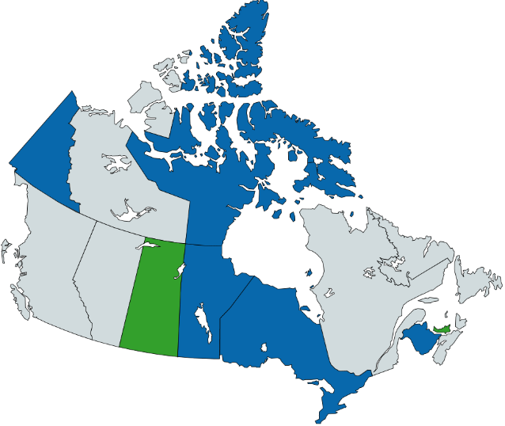
The federal carbon pollution pricing system
Regulatory charge on fuel – applies as of April 2019 in Ontario, New Brunswick, Manitoba, Saskatchewan; and in July 2019 in Yukon and Nunavut
Output-Based Pricing System or OBPS – applied as of January 1, 2019 in Ontario, New Brunswick, Manitoba, Prince Edward Island, and partially in Saskatchewan; and in July 2019 in Yukon and Nunavut
Federal backstop
applies in part
Federal backstop
applies in full
Provincial/Territorial system applies

Slide 5
Use of carbon pricing proceeds
Provinces and territories with their own systems
Use proceeds as they choose
Other provinces
Direct proceeds from fuel charge
~90% to residents through Climate Action Incentive payments
remaining to support small to medium enterprises (SMEs), colleges & universities, schools, hospitals, municipalities, non-profits, Indigenous communities
Output-Based Pricing System proceeds
will help further reduce emissions in the sectors subject to the OBPS
Provinces and territories that requested the federal backstop
Direct proceeds returned to gvt

Slide 6
For more information
https://www.canada.ca/en/environment-climate-change/services/climate-change/pricing-pollution-how-it-will-work.html

