Slide 1
Industrial Decarbonisation - The Next Challenge’Carbon:
Climate Summit Lisbon
Norsk Hydro Ltd.
Liv Rathe

Slide 2
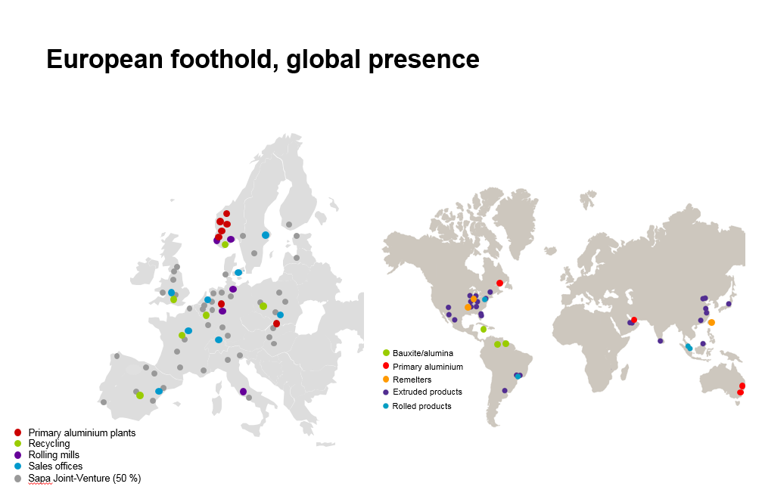
  Norsk Hydro, aluminium mainly based on renewable electricity
In Europe 90% of our electricity consumption is from non-CO₂ emitting generation, while 100% is impacted by CO₂ costs
Europe’s largest aluminium producer
  Primary production in Norway, Germany and Slovakia
  Rolling mills in Germany and Norway
  World leader in extruded solutions
  European recycling facilities
  World most exposed to ETS: 65% of primary production in EU ETS, and 71% in an ETS scheme.
  Electricity sourcing in Europe
  10 TWh hydropower production
  20 TWh consumption in Europe
  Hydro entered up to 30 years PPA of total 4.5 TWh onshore wind
Extruded products

Slide 3

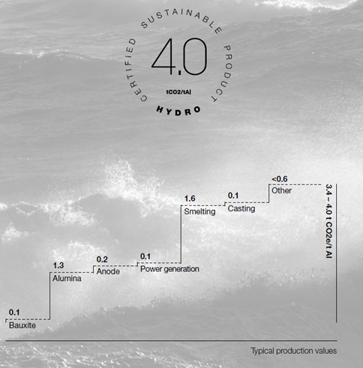

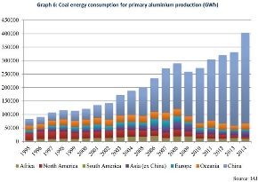
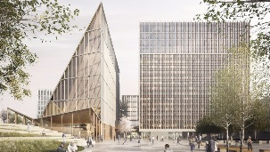
Increased urgency and focus on industrial emissions
Intensified competition among materials
Environmental footprint takes hold as a differentiating quality – competing materials have significant potential for low footprint
Customer driven competition
Competition btw peers on footprint
Requirements from customers on transparency and low footprint
Plastics
Steel
Coal content in Al
New competitors (e.g. wood)
Text
Environmental credentials are fragile?
Market positions change and customers increasingly differentiate suppliers?
Notes:
Enter speaker notes here.

Slide 4
The global climate paradox - I
Global aluminium production by power source
Mill tonnes
Increasing share of global aluminium production is coal-based
Main source for GHG emissions from the electricity production
Forecast

Slide 5

The Carbon Footprint of Aluminium
t CO2e/t Al
By Energy Source
By Region
Source: International Aluminium Institute (IAI)

Slide 6
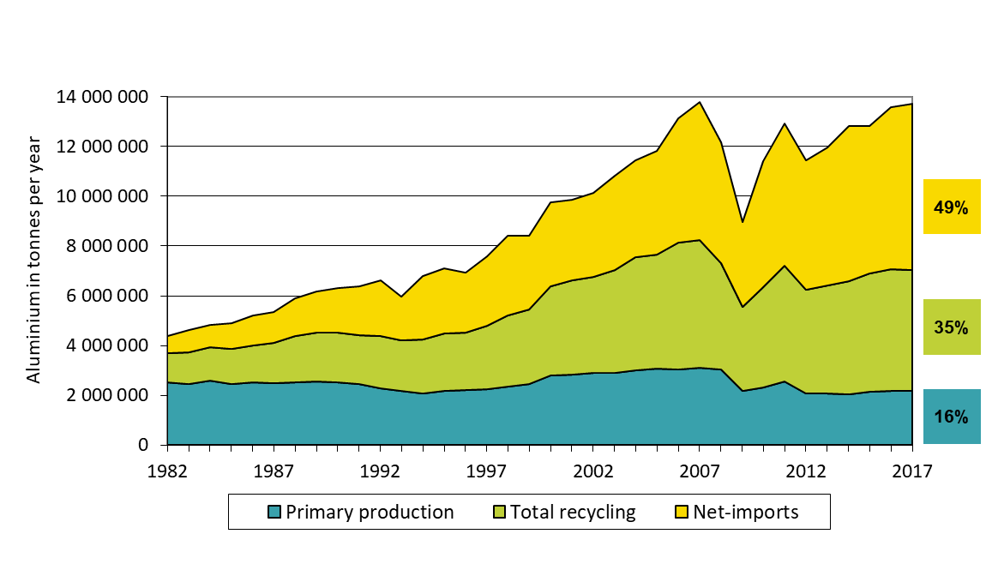
The global climate paradox II
Increasing demand for aluminium products in Europe
Increasing EU import dependency
Only European plants pay CO₂ cost in the power price
Source: CRU
Source: CRU /EA

Slide 7
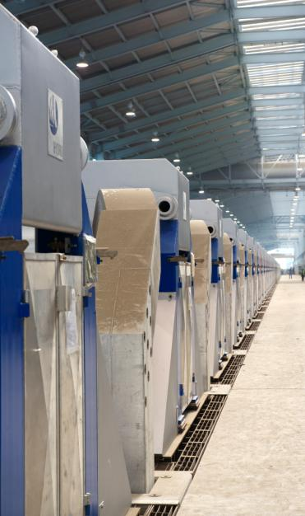
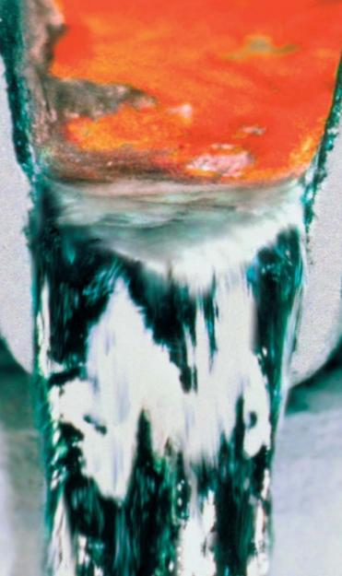
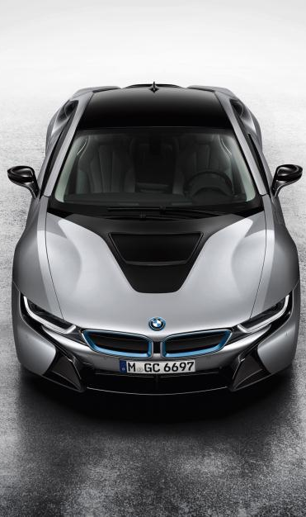
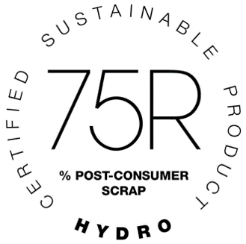
Our response – global view
Production processes, recycling and aluminium in the use-phase are all important
Production technology
Recycling
Aluminium in use
Reduce energy consumption and emissions in our own processes
Reduce production waste and recover energy and value from used products through recycling
Develop products and solutions that reduce energy consumption and emissions in the use-phase
Notes:
Enter speaker notes here.

Slide 8
Our response – smelter view
Probably not one solution, but several initiatives spread out in time
_{100%}
_{50%}
_{0%}
Implement BAT/BAP
New zero direct emission technology
Bio carbon?
Notes:
Enter speaker notes here.

Slide 9
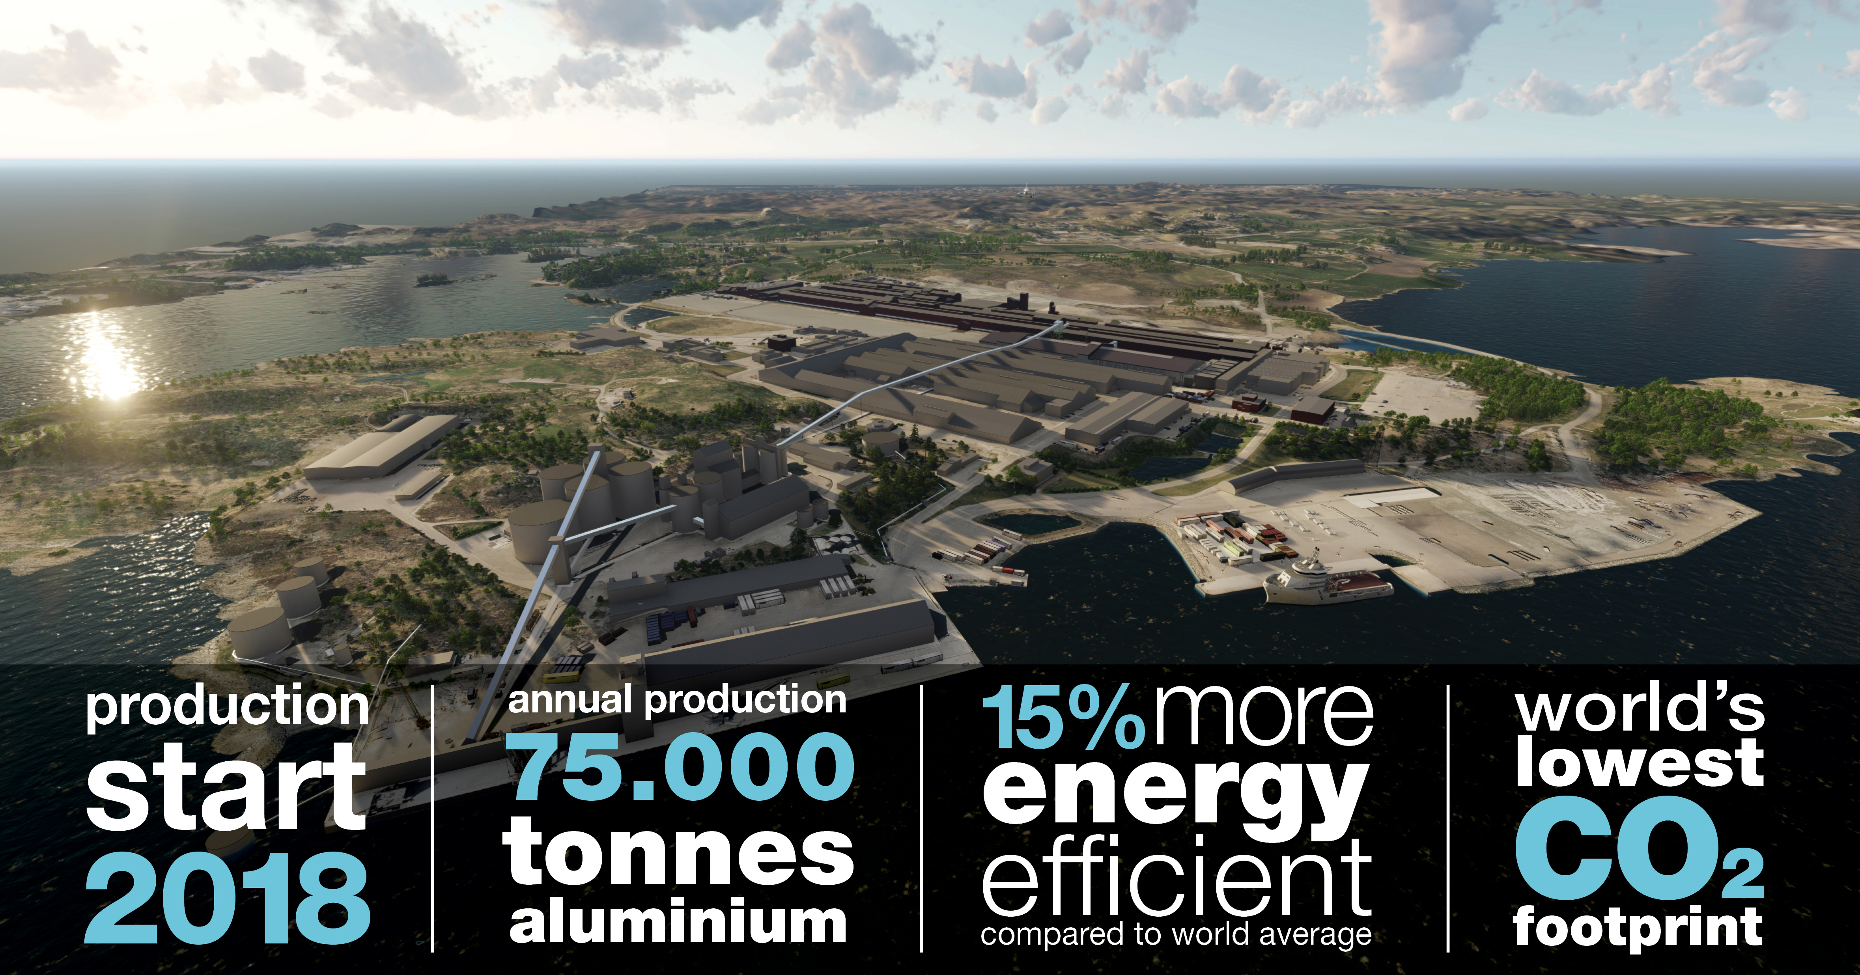
Hydro’s Technology Pilot - Karmøy, Norway
More for less: higher productivity, lower emissions, increased competitiveness
Notes:
Energy consumption of 12.3 kWh/kg Al (world average = 14.1 kWh/kg Al)¹⁾
Direct CO₂ emissions of 1.4-1.45 kg CO₂/kg Al (world average = 2.2 kg CO₂/kg Al)
Aluminium based on hydropower
Automated and connected – a step into digital future

Slide 10
Conclusion
New climate regulation as ETS could drive technology development.
But:
: Currently no low carbon technology exist.
Expensive to develop and even more expensive to implement.
Require comprehensive R&D resources, including piloting and implementation.
And:
Risk is high for carbon leakage to areas with less strict or no carbon regulation .

