Slide 1
EU ETS History & Next Steps
Alessandro Vitelli
16 April 2019

Slide 2
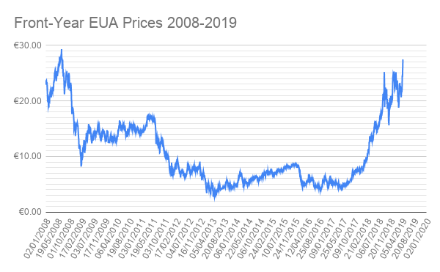
EU ETS Price History
11-year high €27.85
MSR

Slide 3
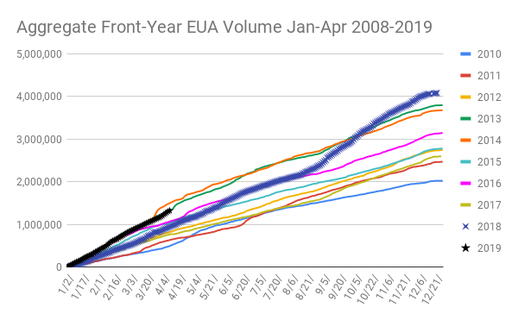
EU ETS Price History

Slide 4
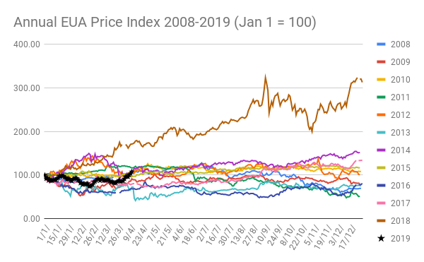
EU ETS Annual Price Performance

Slide 5
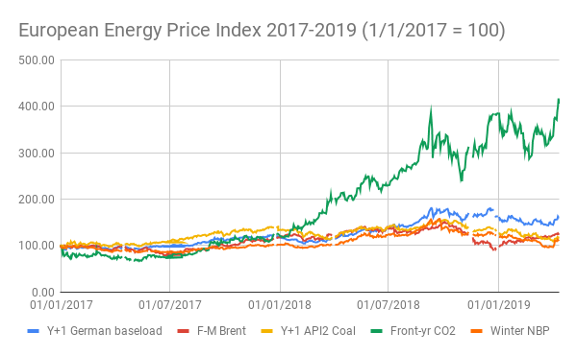
EU Energy Annual Price Performance
MSR
€27.32
€6.14

Slide 6
What’s Next?
MSR — European Commission calculates 2H 19/1H 20 supply reductions
Article 10 auctions 2019-20 — when will they take place?
Brexit — UK/EU must decide how to handle 2019 compliance
Swiss ETS link — (how) will it impact EU ETS?
Article 29a — Will EUA prices reach the trigger point?
National coal phase-out policies elaborated
What abatement comes after fuel switching?

Slide 7
Alessandro Vitelli
Communications
Tel: +44 7710 402060
Mail: vitelli@ieta.org

